Slide 1
Live Classroom
Module 4 –Regression Diagnostics &
Multiple Linear Regression

Slide 2
Topics
Scatterplot Matrices
Multiple Linear Regression
Regression Diagnostics
Questions

Slide 3
Scatterplot Matrices
When you have more than one explanatory variable, you should look at the relationships between each pair of variables
Scatterplot matrix allows you to do this in a single figure
Use pairs(data) function in R
Control contents of panels by specifying upper.panel, lower.panel, and diag.panel (defined ahead of time)

Slide 4
Panel specifications - correlation
panel.cor <- function(x, y, digits=2, prefix="", cex.cor, ...) {
usr <- par("usr")
on.exit(par(usr))
par(usr = c(0, 1, 0, 1))
r <- abs(cor(x, y, use="complete.obs"))
txt <- format(c(r, 0.123456789), digits=digits)[1]
txt <- paste(prefix, txt, sep="")
if(missing(cex.cor)) cex.cor <- 0.8/strwidth(txt)
text(0.5, 0.5, txt, cex = cex.cor * (1 + r) / 2)
}

Slide 5
Panel specifications - histogram
panel.hist <- function(x, ...) {
usr <- par("usr")
on.exit(par(usr))
par(usr = c(usr[1:2], 0, 1.5) )
h <- hist(x, plot = FALSE)
breaks <- h$breaks
nB <- length(breaks)
y <- h$counts
y <- y/max(y)
rect(breaks[-nB], 0, breaks[-1], y, col="white", ...)
}

Slide 6
Panel specifications – linear regression
panel.lm <- function (x, y, col = par("col"), bg = NA, pch = par("pch"),
cex = 1, col.smooth = "black", ...) {
points(x, y, pch = pch, col = col, bg = bg, cex = cex)
abline(stats::lm(y ~ x), col = col.smooth, ...)
}

Slide 7
Example - Age, Height and Salary
In the book Blink by Malcolm Gladwell, Gladwell states that a study of CEOs of Fortune 500 companies found that these individuals tend to be taller than the average US population. In order to study this phenomenon in more detail and to see if height is associated with increased success in business (as measured by salary), 100 men between the ages of 25 and 65 were polled for their heights (in inches) and annual salaries.

Slide 8
Example - Age, Height and Salary – Scatterplot Matrix
pairs(data,upper.panel=panel.cor, diag.panel=panel.hist, lower.panel=panel.lm)

Slide 9
Example - Age, Height and Salary – Scatterplot Matrix

Slide 10
Multiple Linear Regression
Use lm() function to perform regression
lm(data$response~data$explanatory1+data$explanatory2+…)
Use summary() function on the lm() result to obtain the beta coefficients (t-test), R-squared value, F-statistic
ANOVA table to be calculated by hand (if interested, but not necessary!)
Use confint() on the lm() result to obtain confidence intervals for the regression coefficients

Slide 11
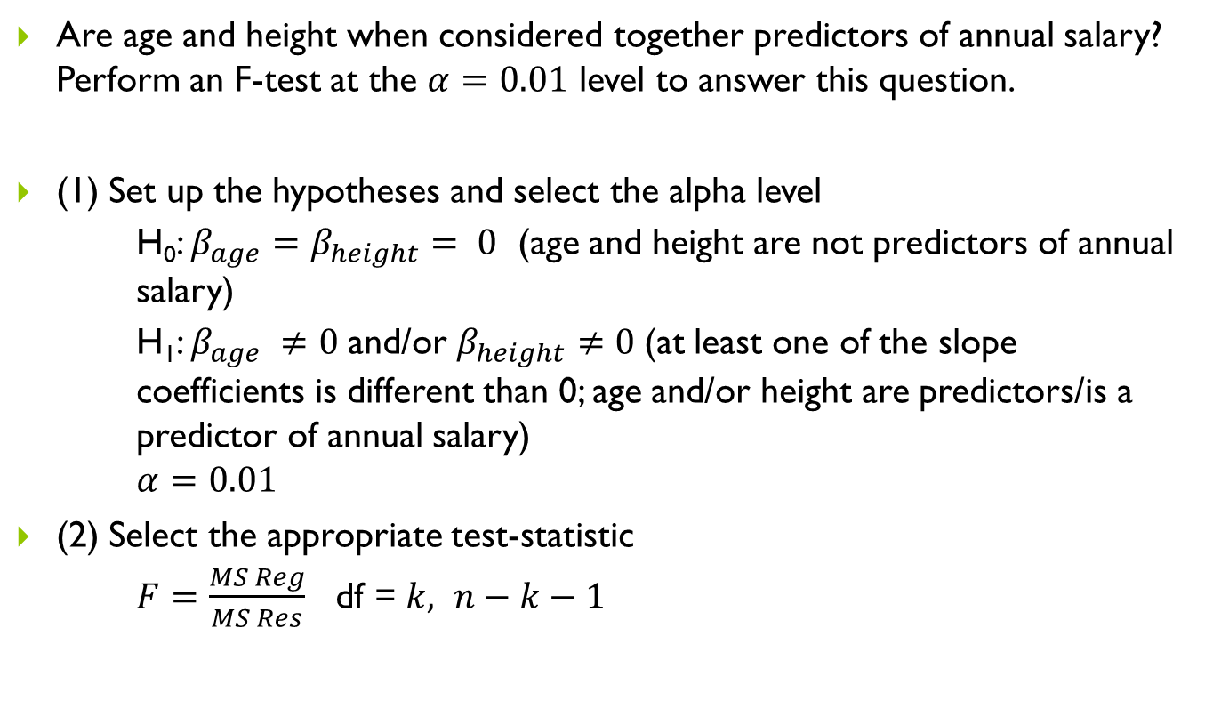
Example - Age, Height and Salary – F-test
Are age and height when considered together predictors of annual salary? Perform an F-test at the $α=0.01$ level to answer this question.
(1) Set up the hypotheses and select the alpha level
H₀: $β_{age}=β_{height}= 0$ (age and height are not predictors of annual salary)
H₁: $β_{age} ≠0$and/or $β_{height}$ $≠0$(at least one of the slope coefficients is different than 0; age and/or height are predictors/is a predictor of annual salary)
$$α=0.01$$
(2) Select the appropriate test-statistic
$F=\frac{MS Reg}{MS Res}$ df = $k, n−k−1$

Slide 12

Example - Age, Height and Salary – F-test
(3) State the decision rule
Decision Rule: Reject H₀ if $p$≤ $α.$ Otherwise, do not reject H₀

Slide 13
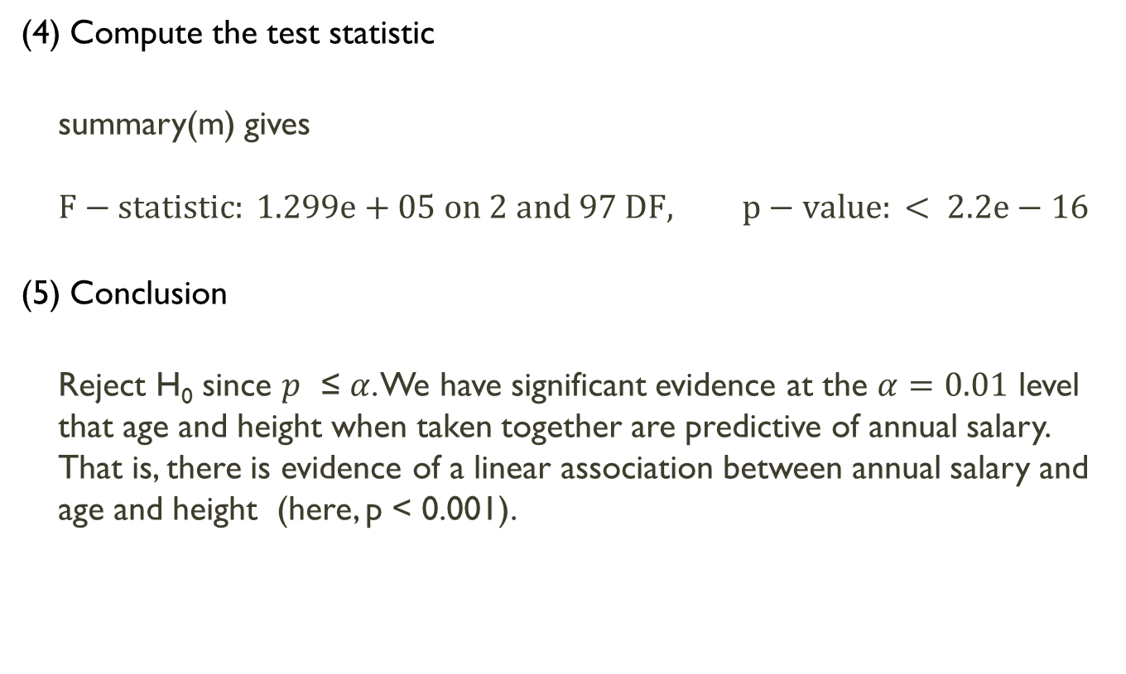
Example - Age, Height and Salary – F-test
(4) Compute the test statistic
summary(m) gives
$$F−statistic: 1.299e+05 on 2 and 97 DF, p−value: < 2.2e−16$$
(5) Conclusion
Reject H₀ since $p$ ≤ $α$. We have significant evidence at the $α=0.01$ level that age and height when taken together are predictive of annual salary. That is, there is evidence of a linear association between annual salary and age and height (here, p < 0.001).

Slide 14
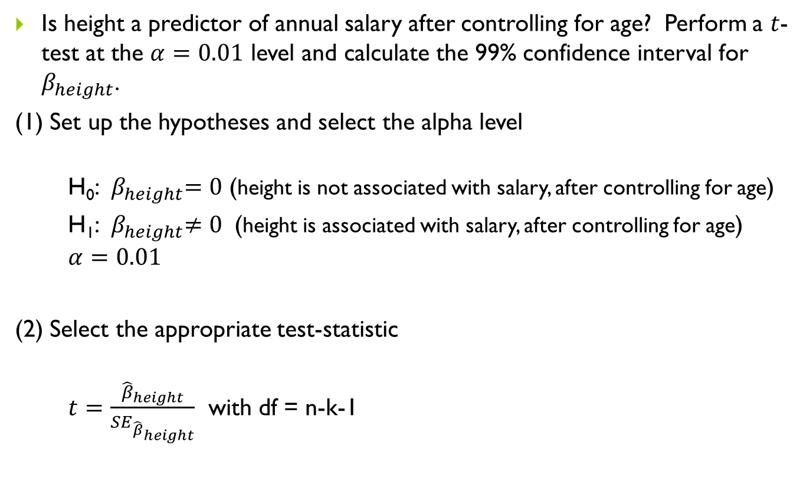
Example - Age, Height and Salary – t-test
Is height a predictor of annual salary after controlling for age? Perform a $t$-test at the $α=0.01$ level and calculate the 99% confidence interval for $β_{height}$.
(1) Set up the hypotheses and select the alpha level
H₀:${ β}_{height}=0$ (height is not associated with salary, after controlling for age)
H₁:${ β}_{height}≠0$ (height is associated with salary, after controlling for age)
$$α=0.01$$
(2) Select the appropriate test-statistic
$t=\frac{{\hat{β}}_{height}}{{SE}_{{\hat{β}}_{height}}}$ with df = n-k-1

Slide 15
Example - Age, Height and Salary – t-test
(3) State the decision rule
Decision Rule: Reject H₀ if $p$≤ $α.$ Otherwise, do not reject H₀

Slide 16
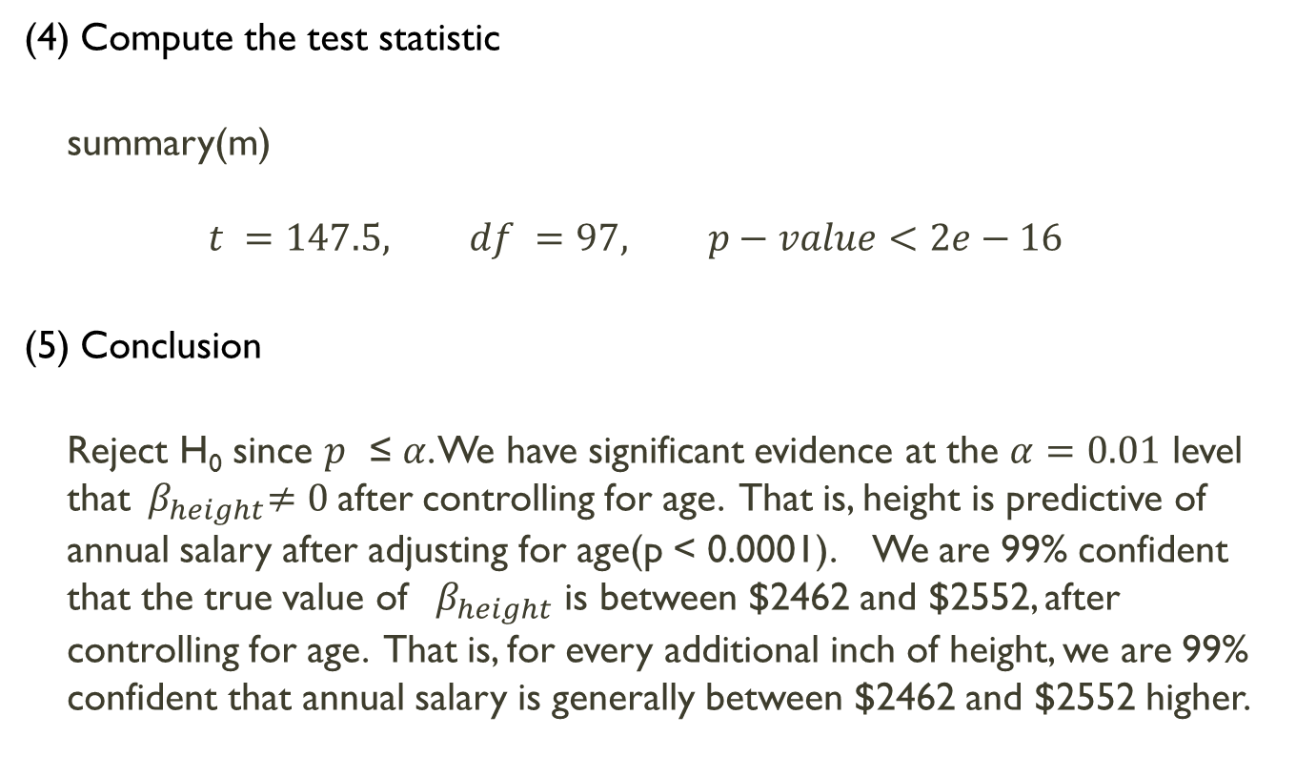
Example - Age, Height and Salary – t-test
(4) Compute the test statistic
summary(m)
$$t =147.5, df =97, p−value<2e−16$$
(5) Conclusion
Reject H₀ since $p$ ≤ $α$. We have significant evidence at the $α=0.01$ level that${ β}_{height}≠0$after controlling for age. That is, height is predictive of annual salary after adjusting for age(p < 0.0001). We are 99% confident that the true value of ${ β}_{height}$ is between $2462 and $2552, after controlling for age. That is, for every additional inch of height, we are 99% confident that annual salary is generally between $2462 and $2552 higher.

Slide 17
Regression Diagnostics
Check the assumptions
Linearity
Independence
Constant variance
Normally distributed residuals
Residual Plots (to assess linearity and constant variance)
plot([variable for x-axis],resid(m))
Check each explanatory variable, and the fitted values (fitted(m))
Histograms (to check the distribution of the residuals)
hist(resid(m))
Regression assumptions least sensitive to departures from this assumption

Slide 18
Example - Salary versus Age and Height – Regression Diagnostics
plot(fitted(m),resid(m), axes=TRUE, frame.plot=TRUE, xlab = "fitted values", ylab="residuals")
plot(data$age,resid(m), axes=TRUE, frame.plot=TRUE, xlab = "age", ylab="residuals")
plot(data$height,resid(m), axes=TRUE, frame.plot=TRUE, xlab = "height", ylab="residuals")
hist(resid(m))

Slide 19
Example – Salary versus Age and Height – regression diagnostics

